Slide 1
DATA MANAGEMENT
Done By: Radhi Priya Janakiraman

Slide 2
AGENDA:
Different types of Data Attributes
Statistical analysis used for different data attributes
Pre-Processing of data

Slide 3
DIFFERENT TYPES OF DATA ATTRIBUTES
Data Attribute: A data field that represents characteristics or features of a data object.
(Example: For a customer object attribute, can be customer ID, address etc.)
A set of attributes used to describe a given object are known as attribute vector.
Type of Data Attributes:
- Qualitative (Nominal (N), Ordinal (O), Binary (B))
- Quantitative (Numeric, Discrete, Continuous)

Slide 4
DIFFERENT TYPES OF DATA ATTRIBUTES (cont)
Quantitative (Nominal (N)) – Related to Names
Example values of a nominal attribute are names of things, represents a country or state and hence it can also be referred as categorical attributes.
Example:
Attribute | Values
Colours | Black, Yellow, Pink
Categorical Data | Lecturer, Principal, Vice-Principal

Slide 5
DIFFERENT TYPES OF DATA ATTRIBUTES (cont)
Quantitative (Ordinal (O))
Values of an Ordinal attributes contain values that have a structured sequence or ranking order between them but the interval between values is unknown, the order of values show what is important but it does not indicate how important the order is.
Example:
Attribute | Values
Grade | A,B,C,D,E,F
Basic Pay Scale | 14, 17, 20

Slide 6
DIFFERENT TYPES OF DATA ATTRIBUTES (cont)
Quantitative (Binary (B)) – Has only 2 values/states.
An example would be yes/no, true/false.
(i) Symmetric : Both values are equally important (eg. Gender)
(ii) Asymmetric : Both values are not equally important (eg. Result)
Example: Symmetric
Example: Asymmetric
Attribute | Values
Gender | Male, Female
Attribute | Values
HIV detected | Yes, No
result | Pass, Fail

Slide 7
DIFFERENT TYPES OF DATA ATTRIBUTES (cont)
Qualitative (Numeric) – Measurable quantity, represented in integer or real values. There are 2 types; interval and ratio.
(i) Interval-scaled
- has values whose differences are interpretable
- numerical values have zero point (no right inference point)
- data can be added and subtracted but cannot be multiplied or divided.
- Example: If a day’s temperature in one day is twice as the other day, it cannot be interpreted as one day is twice as hot as another day.
(ii) Ratio-scaled
- Has a fix zero point
- If something is ratio-scaled, we can say that the value of being multiplied of another value. Differences can be computed and the mean,median,mode etc.

Slide 8
DIFFERENT TYPES OF DATA ATTRIBUTES (cont)
Qualitative (Discrete) – finite values which can be numerical/categorical. These attributes has finite/infinite set of values.
Qualitative (Continuous) – infinite number of states. It is of float type. There can be many values between 2 and 3.
Attribute | Values
Profession | Teacher, student
ZIP Code | 470401,520817
Attribute | Values
Height | 5.2,6.2…etc
Weight | 71.23…etc

Slide 9
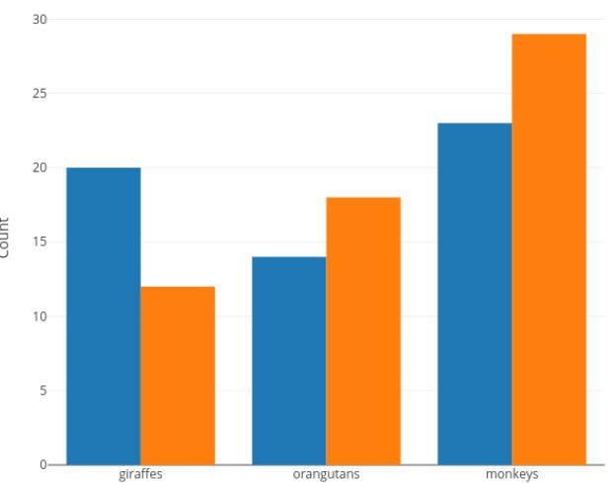
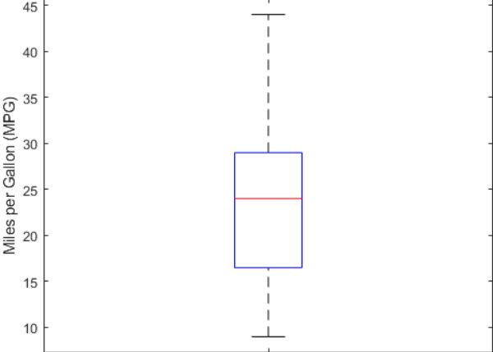
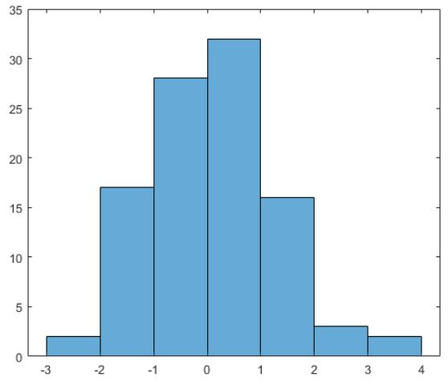
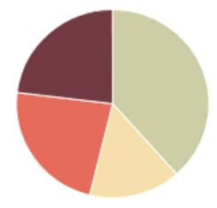
STATISTICAL ANALYSIS USED FOR DIFFERENT DATA ATTRIBUTES
Nominal Data:
Information is collected through
Frequency: Rate at which an event occurs over a period of time within a dataset.
- Method: Pie Chart/Bar chart
Continuous Data:
Data can be summarized using percentiles, median, interquartile range, mean, mode, standard deviation and range.
- Method: Boxplot/Histogram
Ordinal Data: Same methods as nominal data, but there is access to some additional tools such as percentiles, median, mode and interquartile range can be used to summarize data.

Slide 10
PRE-PROCESSING OF DATA
Definition: It is a technique which involved transforming raw data into an understandable format. Real-world data, like the one given (crime rates in Denver), are incomplete, inconsistent and lack in certain behaviours or trends, and hence data pre-processing helps to resolve those issues.
Database-driven applications such as customer-relationship management and rule-based applications like neural networks are being used.

Slide 11
PRE-PROCESSING OF DATA (CONT)
DATA CLEANING
DATA INTEGRATION
DATA TRANSFORMATION
DATA REDUCTION
DATA DISCRETIZATION

